Slide 1
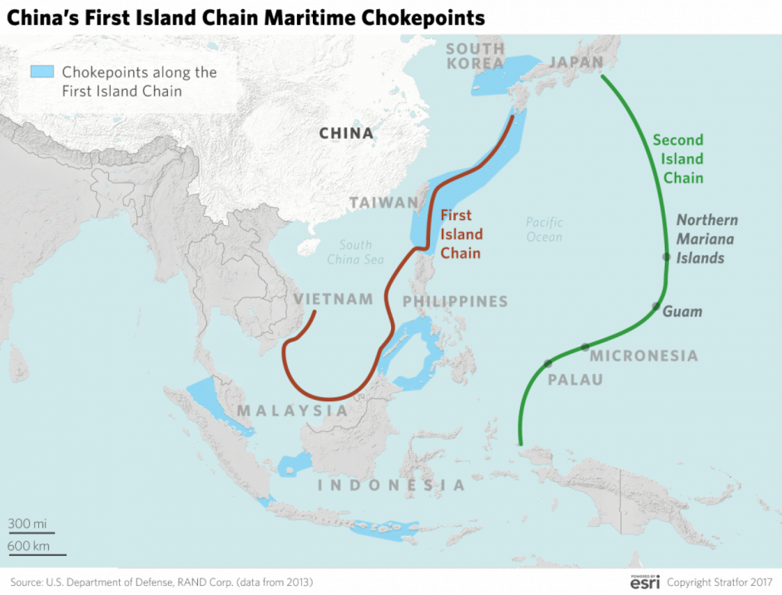
1st & 2nd ISLAND CHAINS
The First Island Chain is defined as the chain of islands that begins at the Kuril Islands, runs through the Japanese Archipelago, the Ryukyu Islands and the island of Taiwan, the northwestern portion of the Philippines (particularly Luzon, Mindoro and Palawan) and finishes towards Borneo, and used to extend to the Spratly Island and the southern Vietnamese coast prior to the Vietnam War. The chain also serves as the maritime boundaries between the East China Sea and the Philippine Sea, and the South China Sea and the Sulu Sea.
The First Island Chain was conceptualized during the Cold War as the first line of defense to contain the spread of influence of the Soviet Union and its allied socialist countries in East and Southeast Asia. The midpoint and key part of the first chain was – and still is — Taiwan. Because the island chain is composed of a series of landmasses, it is also called the "unsinkable aircraft carrier", especially in reference to Taiwan.
The Second Island Chain can refer to two different interpretations, but the version most commonly used refers to the island chain which is formed by Japan's Bonin Islands and Volcano Islands, in addition to the Mariana Islands (most notably Guam, an unincorporated American overseas territory with a heavily fortified military base), western Caroline Islands (Yap and Palau), and extends to Western New Guinea. The chain serves as the eastern maritime boundary of the Philippine Sea. As it is located within the middle portion of the West Pacific, it acts as a second strategic defense line for the United States.
The Third Island Chain is the final part of the strategy. This island chain begins at the Aleutian Islands and runs south across the center of the Pacific Ocean towards Oceania, through the Hawaiian Islands, American Samoa and Fiji, to reach New Zealand. Australia serves as the staple between the second and third chains
17 May 2022
FOR INTERNAL USE ONLY
OPR: AMC/A9
Notes:
1

